Slide 1

“ SUTEX BANK COLLEGE OF COMPUTER APPLICATIONS & SCIENCE “

Slide 2
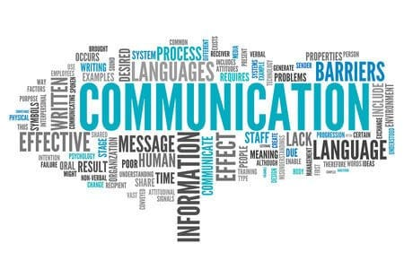
Communication skill
FYBCA – 05
GROUP NO. - 20

Slide 3
504 – ABHI ASODARIYA
506 – DHRUV BHIKADIYA
507 – RAM CHAUHAN
514 – HARSH DHOLA
528 – RONAK KATHIRIYA
539 – DARSHIL MALAVIYA
542 – AKSH MAVANI

Slide 4

“ DEFINATION, TYPES, IMPORTANCE
OF COMMUNICATION ”

Slide 5
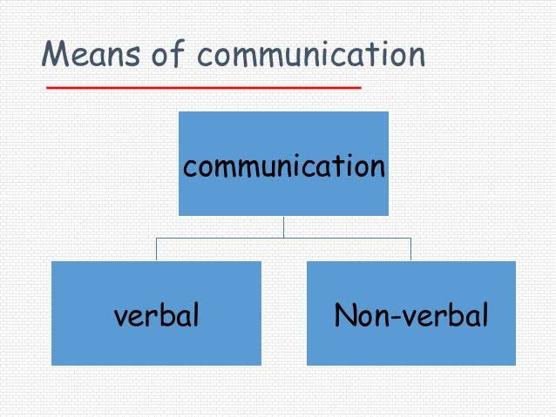
types of communication.
There are two main types of communication :-
1) Verbal :
- oral.
- written.
Non-Verbal :
- visual.
- aural.

Slide 6
1. Verbal communication.
Verbal communication occurs when we engage in speaking with others. It can be face-to-face, over the telephone, via Skype or Zoom, etc. Some verbal engagements are informal, such as chatting with a friend over coffee or in the office kitchen, while others are more formal, such as a scheduled meeting. Regardless of the type, it is not just about the words, it is also about the caliber and complexity of those words, how we string those words together to create an overarching message, as well as the intonation (pitch, tone, cadence, etc.) used while speaking. And when occurring face-to-face, while the words are important, they cannot be separated from non-verbal communication.

Slide 7
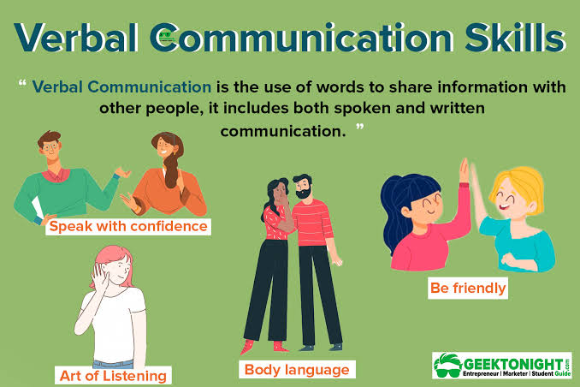
1) Verbal :
Oral
This is the communication which employs the spoken word, either direct or indirect as a communication channel. This verbal communication could be made on a channel that passes information in only one form i.e. sound. You could converse either face to face, or over the phone, or via voice notes or chat rooms, etc. It all comes under the oral communication. This form of communication is an effective form.

Slide 8
2. Written :-
Whether it is an email, a memo, a report, a Facebook post, a Tweet, a contract, etc. all forms of written communication have the same goal to disseminate information in a clear and concise manner – though that objective is often not achieved. In fact, poor writing skills often lead to confusion and embarrassment, and even potential legal jeopardy. One important thing to remember about written communication, especially in the digital age, is the message lives on, perhaps in perpetuity. Thus, there are two things to remember: first, write well – poorly constructed sentences and careless errors make you look bad; and second, ensure the content of the message is something you want to promote or be associated with for the long haul.

Slide 9
2. non-verbal :
What we do while we speak often says more than the actual words. Non-verbal communication includes facial expressions, posture, eye contact, hand movements, and touch. For example, if you’re engaged in a conversation with your boss about your cost-saving idea, it is important to pay attention to both the their words and their non-verbal communication. Your boss might be in agreement with your idea verbally, but their nonverbal cues: avoiding eye contact, sighing, scrunched up face, etc. indicate something different.

Slide 10
[2] Non-verbal
Visual :
This is communication through visual aids like drawings, placards, presentations, and illustrations, etc.

Slide 11
2. Aural :
Aural communication can be defined as a method of transmitting information through the auditory sensory system i.e. speaking and hearing. It can used to transmit information either individually or along with visual communication.

Slide 12
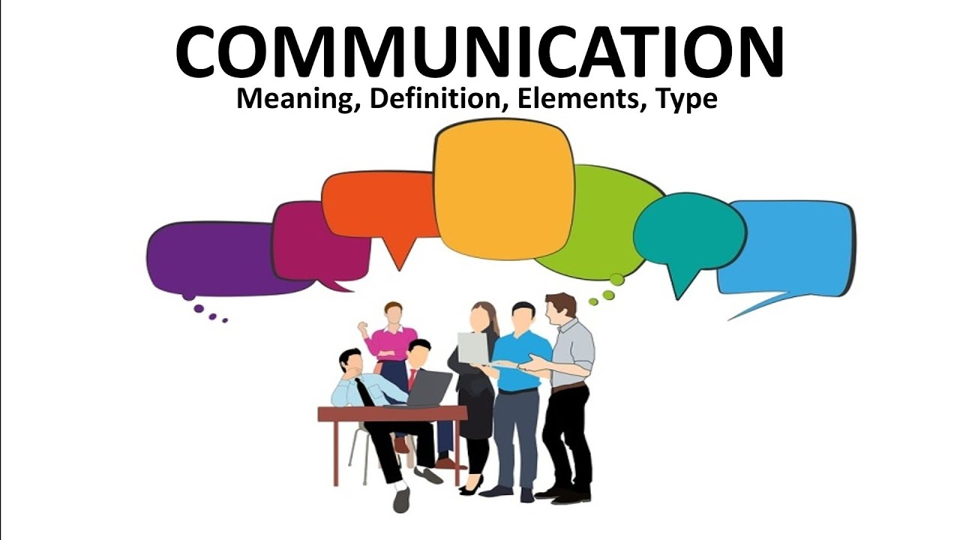
DEFINATION OF COMMUNICATION :
Communication is simply the act of transferring information from one place, person or group to another.
Every communication involves (at least) one sender, a message and a recipient. This may sound simple, but communication is actually a very complex subject.

Slide 13
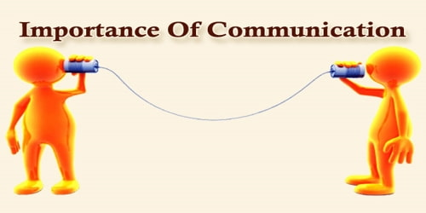
Importance of communication :
Basis of Decision-Making and Planning:
Communication is essential for decision-making and planning. It enables the management to secure information without which it may not be possible to take any decision. The quality of managerial decisions depends upon the quality of communication. Further, the decisions and plans of the management need to be communicated to the subordinates. Without effective communication, it may not be possible to issue instructions to others. Effective communication helps in proper implementation of plans and policies of the management.

Slide 14
2. Smooth and Efficient Working of an Organisation:
In the words of George R. Terry, “It serves as the lubricant, fostering for the smooth operations of management process.” Communication makes possible the smooth and efficient working of an enterprise. It is only through communication that the management changes and regulates the actions of the subordinates in the desired direction.

Slide 15
3. Facilitates Co-Ordination:
Management is the art of getting things done through others and this objective of management cannot be achieved unless there is unity of purpose and harmony of effort. Communication through exchange of ideas and information helps to bring about unity of action in the pursuit of common purpose. It binds the people together and facilitates co-ordination.

Slide 16
4. Increases Managerial Efficiency:
Effective communication increases managerial efficiency. It is rightly said that nothing happens in management until communication takes place. The efficiency of manager depends upon his ability to communicate effectively with the members of his organisation. It is only through communication that management conveys its goals and desires, issues instructions and orders, allocates jobs and responsibility and evaluates performance of subordinates.

Slide 17
5. Promotes Co-operation and Industrial Peace:
Effective communication creates mutual understanding and trust among the members of the organisation. It promotes co-operation between the employer and the employees. Without communication, there cannot be sound industrial relations and industrial peace. It is only through communication that workers can put in their grievances, problems and suggestions to the management.

Slide 18
6. Helps in Establishing Effective Leadership:
Communication is the basis of effective leadership. There cannot be any leadership action without the effective communication between the leader and the led. Communication is absolutely necessary for maintaining man to man relationship in leadership. It brings the manager (leader) and the subordinates (led) in close contact with each other and helps in establishing effective leadership.

Slide 19
7. Motivation and Morale:
Communication is the means by which the behaviour of the subordinates is modified and change is effected in their actions. Through communication workers are motivated to achieve the goals of the enterprise and their morale is boosted. Although motivation comes from within yet the manager can also motivate people by effective communication, e.g., proper drafting of message, proper timing of communication and the way of communication, etc.

Slide 20
8. Increases Managerial Capacity:
Effective communication increases managerial capacity too. A manager is a human being and has limitations as to time and energy that he can devote to his activities. He has to assign duties and responsibilities to his subordinates. Through communication, a manager can effectively delegate his authority and responsibility to others and thus, increases his managerial capacity.

Slide 21
9. Effective Control:
Managerial function of control implies the measurement of actual performance, comparing it with standards set by plans and taking corrective actions of deviations, if any, to ensure attainment of enterprise objectives according to preconceived and planned acts. Communication acts as a tool of effective control. The plans have to be communicated to the subordinates, the actual performance has to be measured and communicated to the top management and a corrective action has to be taken or communicated so as to achieve the desired goals. All this may not be possible without an efficient system of communication.

Slide 22
10. Job Satisfaction:
Effective communication creates job satisfaction among employees as it increases mutual trust and confidence between management and the employees. The gap between management and the employees is reduced through the efficient means of communication and a sense of belongingness is created among employees. They work with zeal and enthusiasm.

Slide 23
11. Democratic Management:
Communication is also essential for democratic management. It helps to achieve workers participation in management by involving workers in the process of decision-making. In the absence of an efficient system of communication, there cannot be any delegation and decentralization of authority.

Slide 24
12. Increases Productivity and Reduces Cost:
Effective communication saves time and effort. It increases productivity and reduces cost. Large- scale production involves a large number of people in the organisation. Without communication, it may not be possible to work together in a group and achieve the benefits of large-scale production.

Slide 25
13. Public Relations:
In the present business world, every business enterprise has to create and maintain a good corporate image in the society. It is only through communication that management can present a good corporate image to the outside world. Effective communication helps management in maintaining good relations with workers, customers, suppliers, shareholders, government and community at large.

Slide 26
14. FEEDBACK:
THE PURPOSE OF COMMUNICATION WILL BE DEFEATED IF FEEDBACK IS NOT TAKEN FROM THE RECEIVER.
THE CONFIRMATION OF THE RECEIPT OF THE MESSAGE IN ITS RIGHT PERSPECTIVE FROM ITS RECEIVER FULFILLS THE OBJECT OF COMMUNICATION.
THE FEEDBACK IS ESSENTIAL ONLY IN CASE OF WRITTEN COMMUNICATION AND MESSAGES SENT THROUGH MESSENGERS. IN CASE OF ORAL TYPE OF COMMUNICATION THE FEEDBACK IS IMMEDIATELY KNOWN.

Slide 27
THE END…
THANKS FOR WATCHING
-” THE BEST PREPARETION
FOR TOMORROW IS DOING YOUR BEST TODAY..”

